Slide 1
ARDUINO
Experiment - 2
Dr. G. V. Prasanna Anjaneyulu
Serial Monitor & Plotter

Slide 2
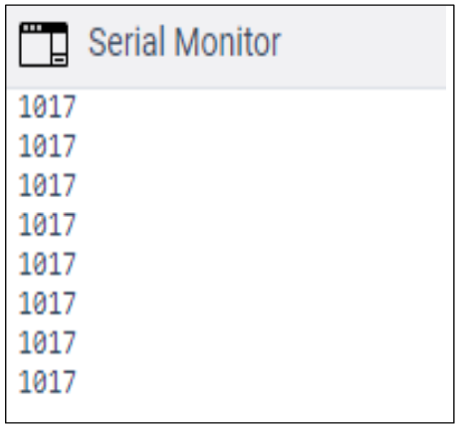
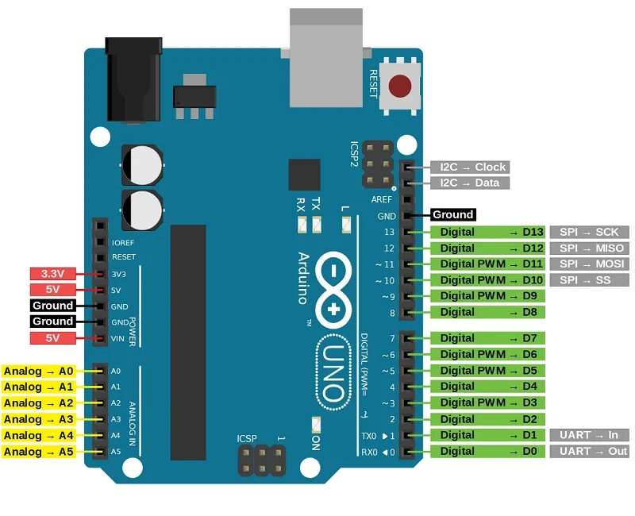
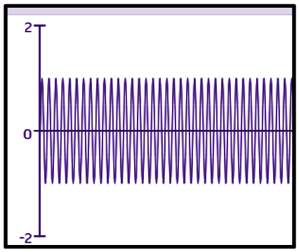
Dr. G. V. Prasanna Anjaneyulu

Slide 3
Experiment - 2
PART - A: Plotting the Serial data from LDR sensor
PART - B: Serial Plotter - Sine waveforms
Dr. G. V. Prasanna Anjaneyulu

Slide 4
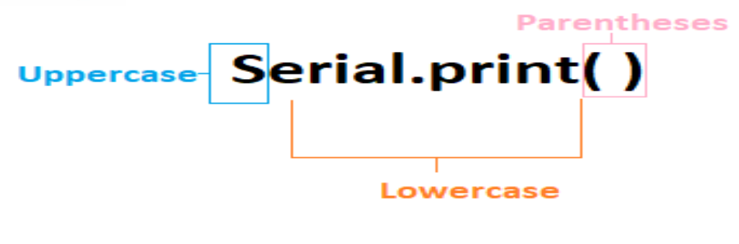
Syntax
Dr. G. V. Prasanna Anjaneyulu

Slide 5
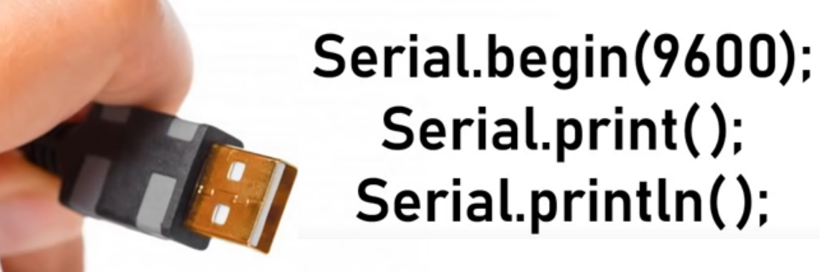
Dr. G. V. Prasanna Anjaneyulu

Slide 6

Serial.begin( )
Dr. G. V. Prasanna Anjaneyulu

Slide 7
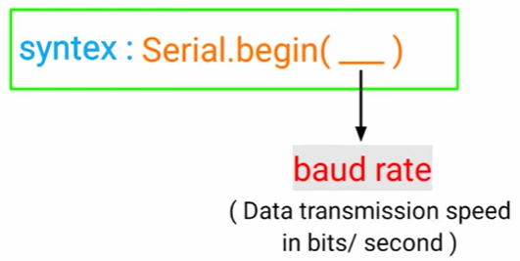
Dr. G. V. Prasanna Anjaneyulu

Slide 8
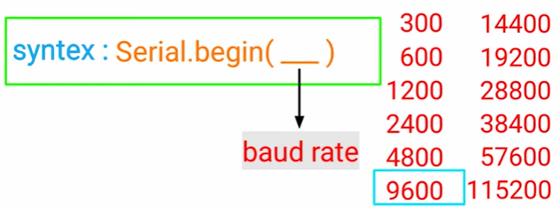
Dr. G. V. Prasanna Anjaneyulu

Slide 9

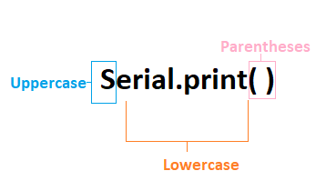

Dr. G. V. Prasanna Anjaneyulu

Slide 10
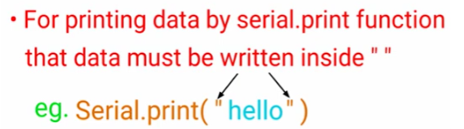
Contd….
Dr. G. V. Prasanna Anjaneyulu

Slide 11
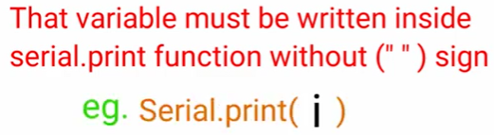
Contd……
Dr. G. V. Prasanna Anjaneyulu

Slide 12


Dr. G. V. Prasanna Anjaneyulu

Slide 13
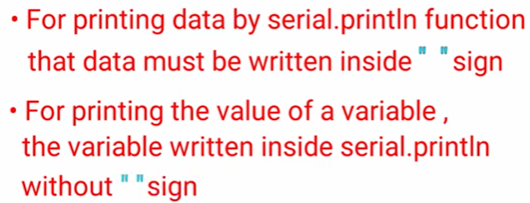
Contd……
Dr. G. V. Prasanna Anjaneyulu

Slide 14
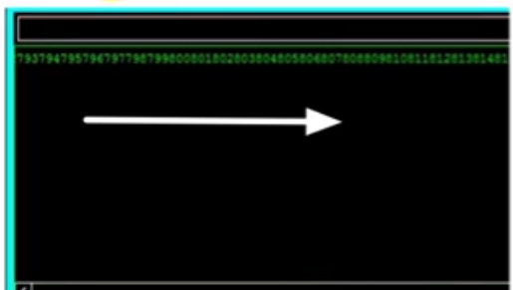
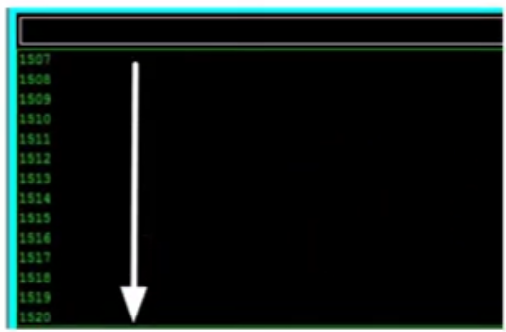
Void setup( )
{
Int i =0;
For (i=0; i<=1000; i++)
{
Serial.print(i)
}
}
Void setup( )
{
Int i =0;
For (i=0; i<=1000; i++)
{
Serial.println(i)
}
}
Dr. G. V. Prasanna Anjaneyulu

Slide 15
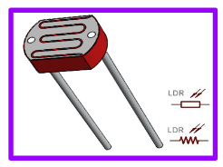
PART - A: Plotting the serial data from LDR sensor
Dr. G. V. Prasanna Anjaneyulu

Slide 16
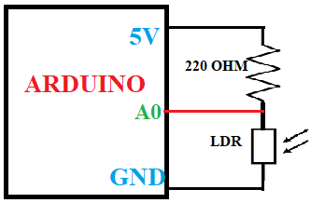
Circuit diagram
Dr. G. V. Prasanna Anjaneyulu

Slide 17
Apparatus
1.PC with Arduino IDE
2.Arduino UNO Board
3.USB cable
4.Light Dependent Resistor(photoresistor)
5.Bread board
6.220Ω resistor
7.Jumper wires
Dr. G. V. Prasanna Anjaneyulu

Slide 18
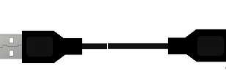

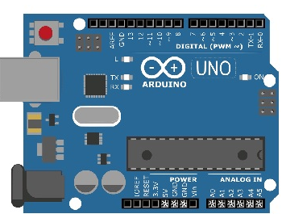
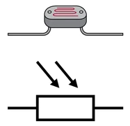
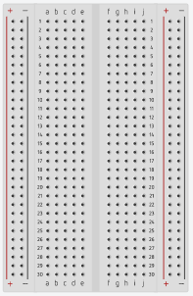
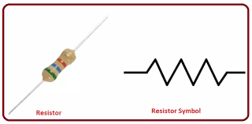
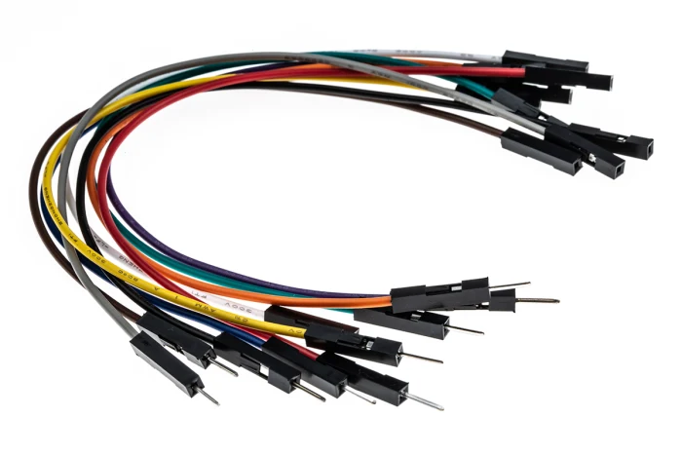
Implementation
Dr. G. V. Prasanna Anjaneyulu

Slide 19
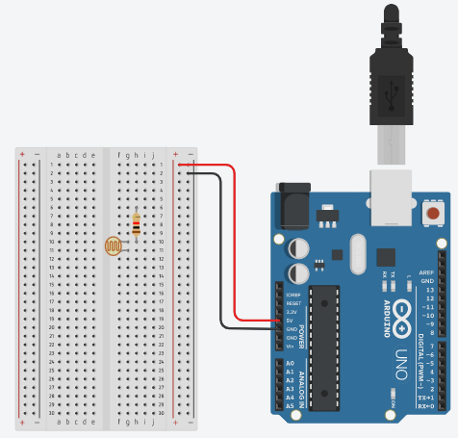
Dr. G. V. Prasanna Anjaneyulu

Slide 20
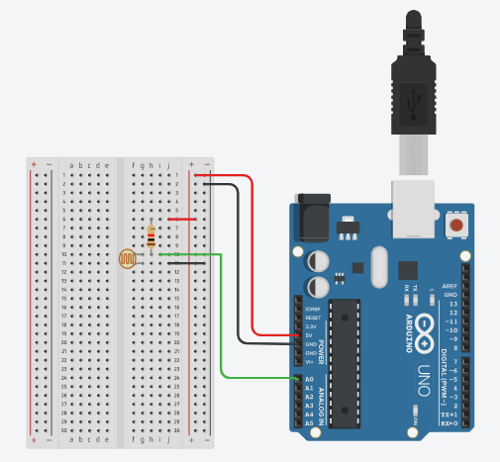
Dr. G. V. Prasanna Anjaneyulu

Slide 21
ARDUINO Program
// PART-A: Serial print & plot of voltage across LDR
void setup()
{
Serial.begin(9600);
}
void loop()
{
Serial.println(analogRead(A0));
}
Dr. G. V. Prasanna Anjaneyulu

Slide 22
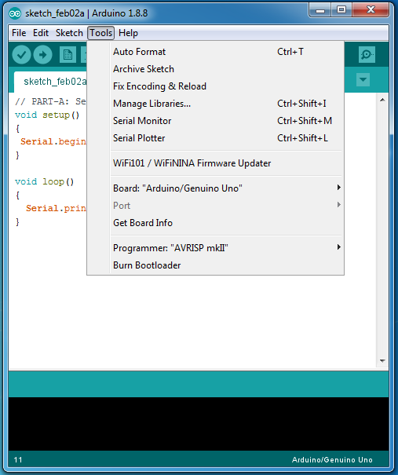
ARDUINO - IDE
Dr. G. V. Prasanna Anjaneyulu

Slide 23
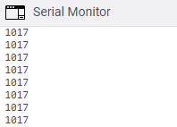
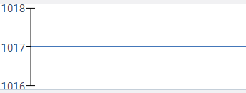
Results
Serial plotter
LDR Value
Dr. G. V. Prasanna Anjaneyulu
time

Slide 24
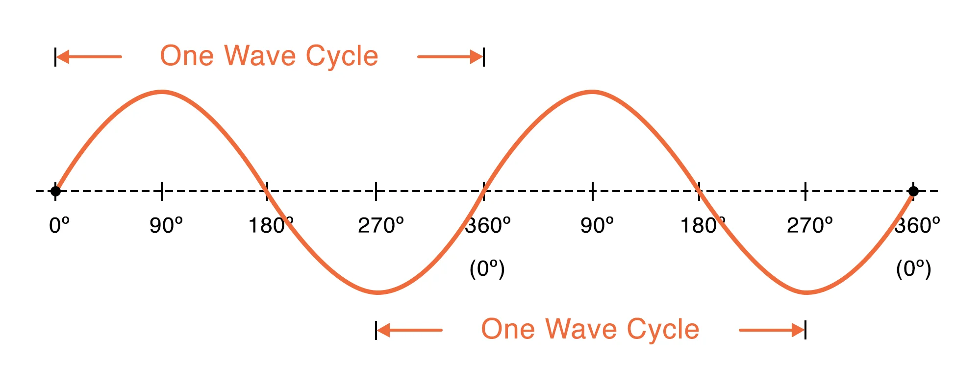
PART - B: Serial Plotter - Sine waveform
Dr. G. V. Prasanna Anjaneyulu

Slide 25
Part-B
//PART-B: printing of sine wave plot
void setup()
{
Serial.begin(9600);
}
void loop()
{
for(int i = 0; i <= 360; i += 30)
{
float y1 = 1 * sin(i * M_PI / 180);
Serial.print(i);
Serial.print(" , ");
Serial.println(y1);
delay(200);
}
}
Dr. G. V. Prasanna Anjaneyulu

Slide 26
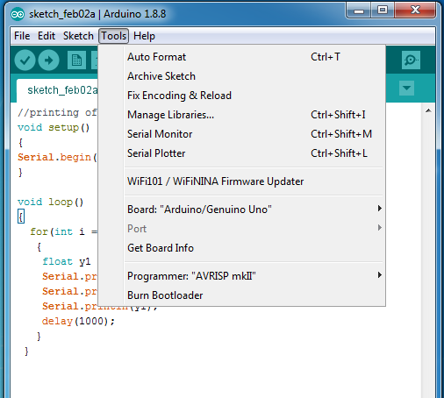
ARDUINO - IDE
Dr. G. V. Prasanna Anjaneyulu

Slide 27
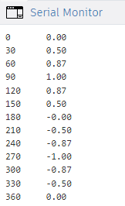
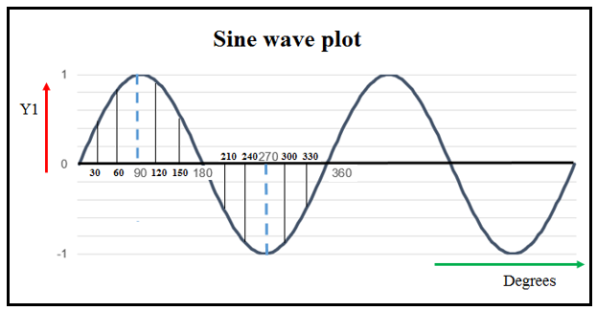
Result
Serial plotter
Dr. G. V. Prasanna Anjaneyulu

Slide 28
PROJECTS - ADVANCED
Dr. G. V. Prasanna Anjaneyulu

Slide 29
LDR based Projects
1.Arduino with LDR Project Using LED Schematics
2.Arduino with LDR Project Using Relay Schematics
3. Automatic Curtain Operation Using LDR
4. LDR Plus GSM Based Security System
5. LDR-Based DC Motor Speed Control
Dr. G. V. Prasanna Anjaneyulu

Slide 30
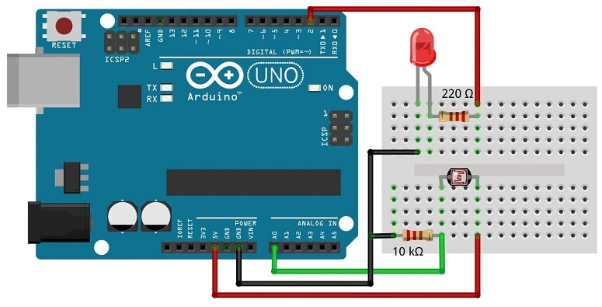
1.Arduino with LDR Project Using LED Schematics
Dr. G. V. Prasanna Anjaneyulu

Slide 31
Program code
int LDRInput=A0; //Set Analog Input A0 for LDR.
int LED=2;
void setup() {
Serial.begin(9600);
pinMode(LDRInput,INPUT);
pinMode(LED,OUTPUT);
}
void loop() {
int value=analogRead(LDRInput);//Reads the Value of LDR(light).
Serial.println("LDR value is :");//Prints the value of LDR to Serial Monitor.
Serial.println(value);
LDR_Threshold=300;
if(value<LDR_Threshold)
{
digitalWrite(LED,HIGH);//The LED turns ON in Dark.
}
else
{
digitalWrite(LED,LOW);//The LED turns OFF in Light.
}
}
Dr. G. V. Prasanna Anjaneyulu

Slide 32
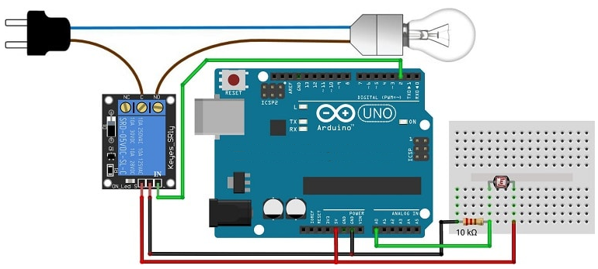
2. Arduino with LDR Project Using Relay Schematics
Dr. G. V. Prasanna Anjaneyulu

Slide 33
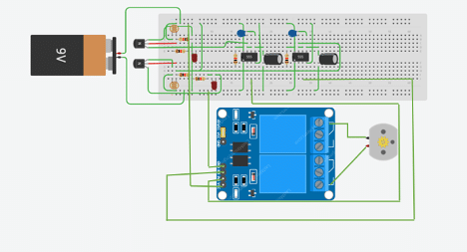
3. Automatic Curtain Operation Using LDR
Dr. G. V. Prasanna Anjaneyulu
https://www.electronicsforu.com/electronics-projects/prototypes/automatic-curtain-operation-using-ldr

Slide 34
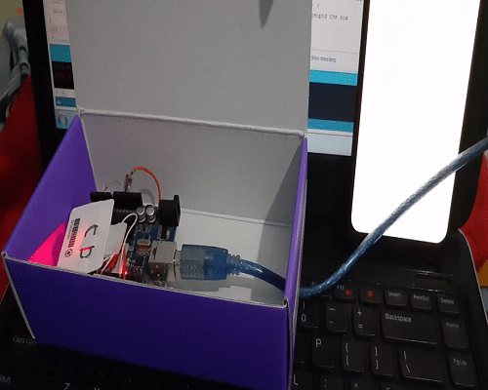
4. LDR Plus GSM Based Security System
Dr. G. V. Prasanna Anjaneyulu
https://www.electronicsforu.com/electronics-projects/ldr-plus-gsm-based-security-system

Slide 35
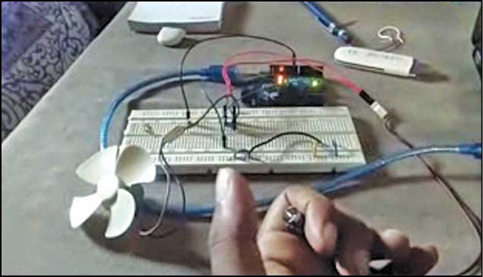
5. LDR-Based DC Motor Speed Control
Dr. G. V. Prasanna Anjaneyulu
https://www.electronicsforu.com/buyers-guides/hardware-buyers-guide/ldr-based-dc-motor-speed-control

Slide 36


